Slide 1

Module 3
Group 1：Yunqing Shao
Xu Zou
Cuizhuo Lu

Slide 2
Content
Data Processing
Exploratory Data Analysis
Model Building
Recommendation For Business

Slide 3
Data Processing & EDA
Business
Breakfast
Breakfast_Restaurant
Review
Business_id
Breakfast_Review
User_id
Important_Breakfast_Review
User
fans > 0
Important_User

Slide 4

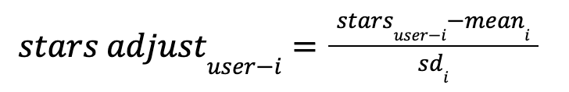
Standardize the Ratings
Why we need standardization ?
How to scale the rating ?
- Get the mean and variance of users’ historical ratings
Perfect
-
Bad

Slide 5
Change of Rating distribution

Slide 6
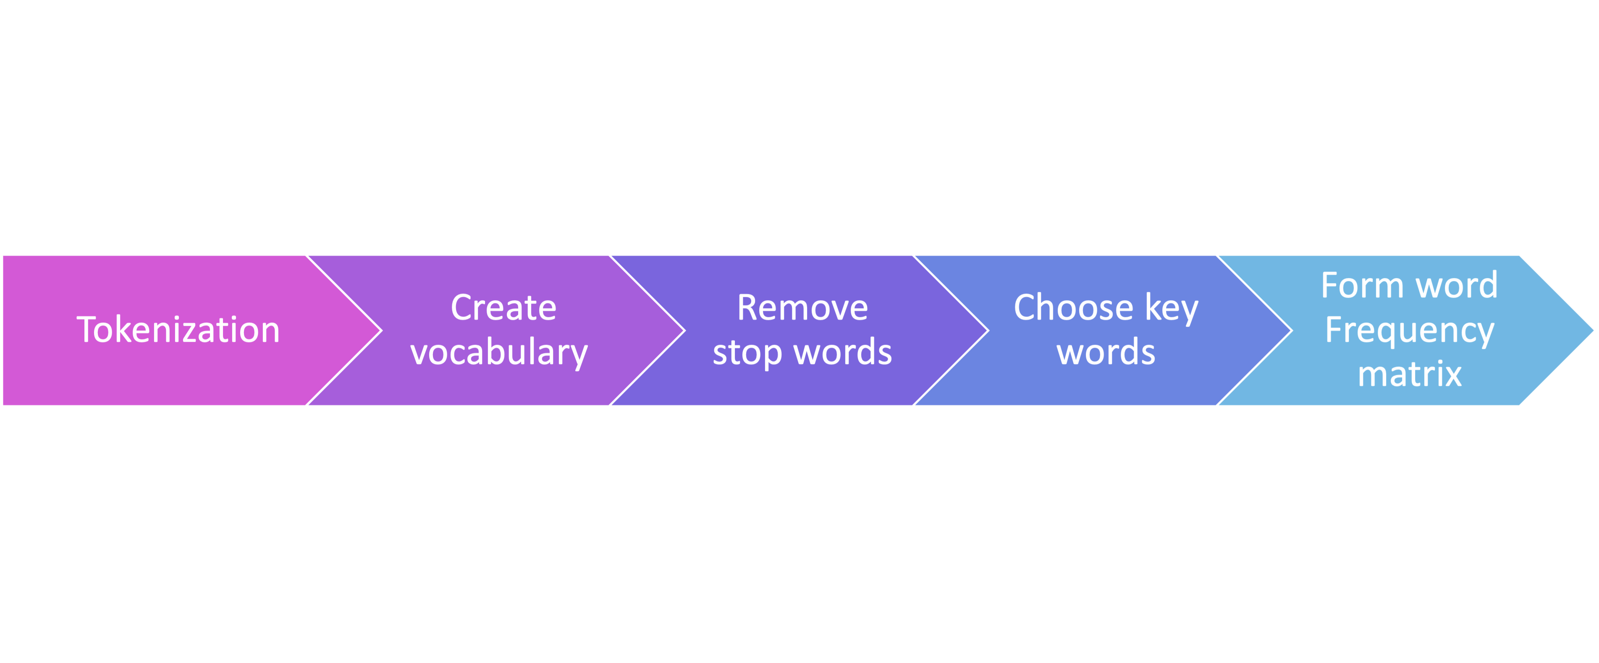
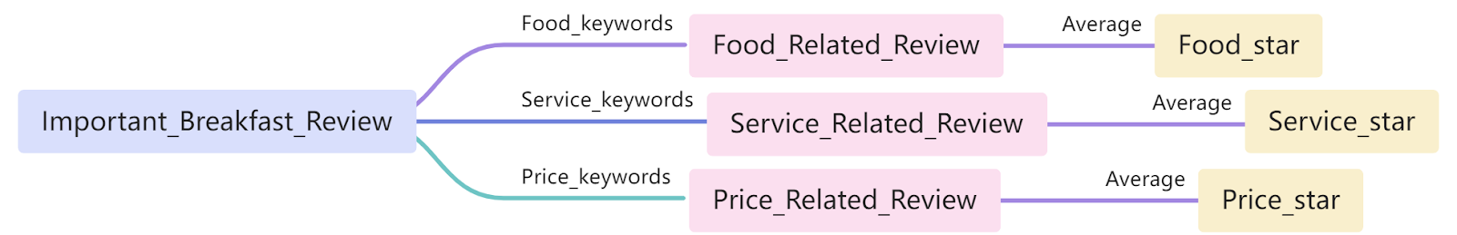
Text Analysis Procedure:
Model
Building
Form 3 kinds of key words:
word categories | key words
Food_keywords | food, delicious, coffee, cheese, fresh, meal, chicken, eggs, sandwich, tasty, drinks, sauce, salad...
Service_keywords | service, friendly, staff, parking...
Price_keywords | price, expensive, cheap, affordable...

Slide 7

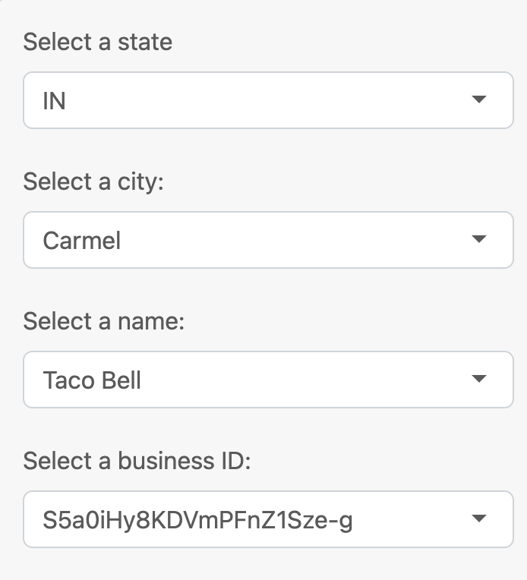
Take Taco Bell as an example :
Recommendation For Business

Slide 8
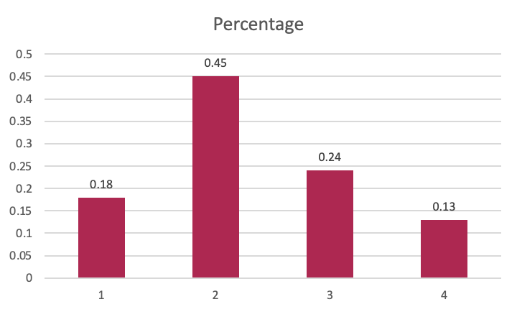
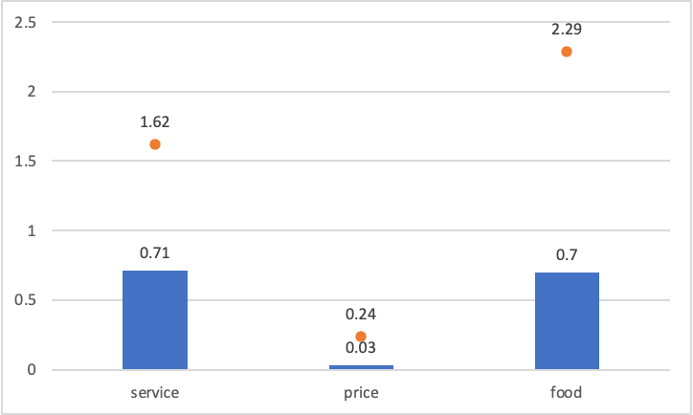
Recommendation for business
Original_stars count
Scaled_stars count
Stars on Three Aspects

Slide 9
Recommendation For Business
Further Analysis on Food and Service
Taco Bell should care more about the quality of cheese and chicken.
Taco Bell should cook faster to avoid users’ long waiting.
The staff of Taco Bell should be more friendly.
Taco Bell should care more about the price.

Slide 10
Thank you !

